Slide 1
ADV-C3 Binary Number system

Slide 2
Basics and definition.
In mathematics and digital electronics, a binary number is a number expressed in the base-2 numeral system or binary numeral system, which uses only two symbols: typically "0" (zero) and "1" (one).
The base-2 numeral system is a positional notation with a radix of 2. Each digit is referred to as a bit. Because of its straightforward implementation in digital electronic circuitry using logic gates, the binary system is used by almost all modern computers and computer-based devices.
In the earlier days of computing, switches, punched holes and punched paper tapes were used to represent binary values.
In a modern computer, the numeric values may be represented by two different voltages; on a magnetic disk, magnetic polarities may be used. A "positive", "yes", or "on" state is not necessarily equivalent to the numerical value of one;

Slide 3
Binary counting
Binary counting follows the same procedure as that of decimal number system, except that only the two symbols 0 and 1 are available. Thus, after a digit reaches 1 in binary, an increment resets it to 0 but also causes an increment of the next digit to the left:
0000,
0001, (rightmost digit starts over, and next digit is incremented)
0010, 0011, (rightmost two digits start over, and next digit is incremented)
0100, 0101, 0110, 0111, (rightmost three digits start over, and the next digit is incremented)
1000, 1001, 1010, 1011, 1100, 1101, 1110, 1111 ...
In the binary system, each digit represents an increasing power of 2, with the rightmost digit representing 20, the next representing 21, then 22, and so on. The value of a binary number is the sum of the powers of 2 represented by each "1" digit. For example, the binary number 100101 is converted to decimal form as follows:
1001012 = [ ( 1 ) × 25 ] + [ ( 0 ) × 24 ] + [ ( 0 ) × 23 ] + [ ( 1 ) × 22 ] + [ ( 0 ) × 21 ] + [ ( 1 ) × 20 ]
1001012 = [ 1 × 32 ] + [ 0 × 16 ] + [ 0 × 8 ] + [ 1 × 4 ] + [ 0 × 2 ] + [ 1 × 1 ]
1001012 = 3710

Slide 4
Binary Code
A binary code represents text, computer processor instructions, or any other data using a two-symbol system. The two-symbol system used is often "0" and "1" from the binary number system. The binary code assigns a pattern of binary digits, also known as bits, to each character, instruction, etc.
For example, a binary string of eight bits can represent any of 256 possible values and can, therefore, represent a wide variety of different items.
In computing and telecommunications, binary codes are used for various methods of encoding data, such as character strings, into bit strings. Those methods may use fixed-width or variable-width strings. In a fixed-width binary code, each letter, digit, or other character is represented by a bit string of the same length; that bit string, interpreted as a binary number, is usually displayed in code tables in octal, decimal or hexadecimal notation. There are many character sets and many character encodings for them.
A bit string, interpreted as a binary number, can be translated into a decimal number. For example, the lower case a, if represented by the bit string 01100001 (as it is in the standard ASCII code), can also be represented as the decimal number "97".

Slide 5
Bits and Bytes: At the smallest scale in the computer, information is stored as bits and bytes.
Bits (also known as a Shannon)
Bytes
a "bit" is atomic: the smallest unit of storage
A bit stores just a 0 or 1
"In the computer it's all 0's and 1's" ... bits
Anything with two separate states can store 1 bit
In a chip: electric charge = 0/1
In a hard drive: spots of North/South magnetism = 0/1
A bit is too small to be much use
Group 8 bits together to make 1 byte
The byte is a unit of digital information that most commonly consists of eight bits
One byte = collection of 8 bits
e.g. 0 1 0 1 1 0 1 0
One byte can store one character, e.g. 'A' or 'x' or '$'

Slide 6
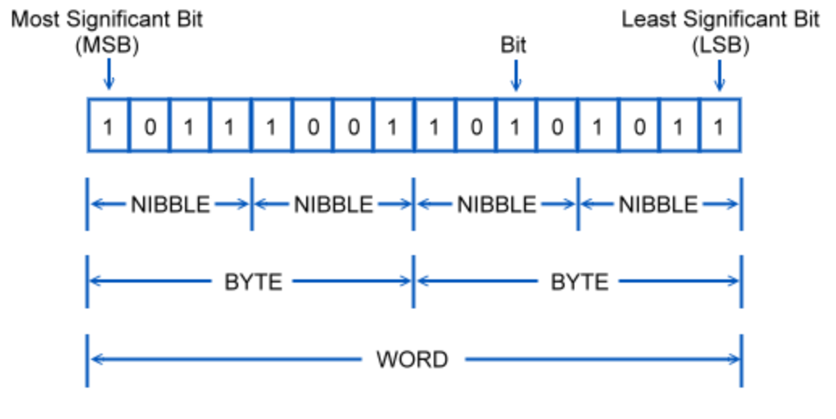

Slide 7
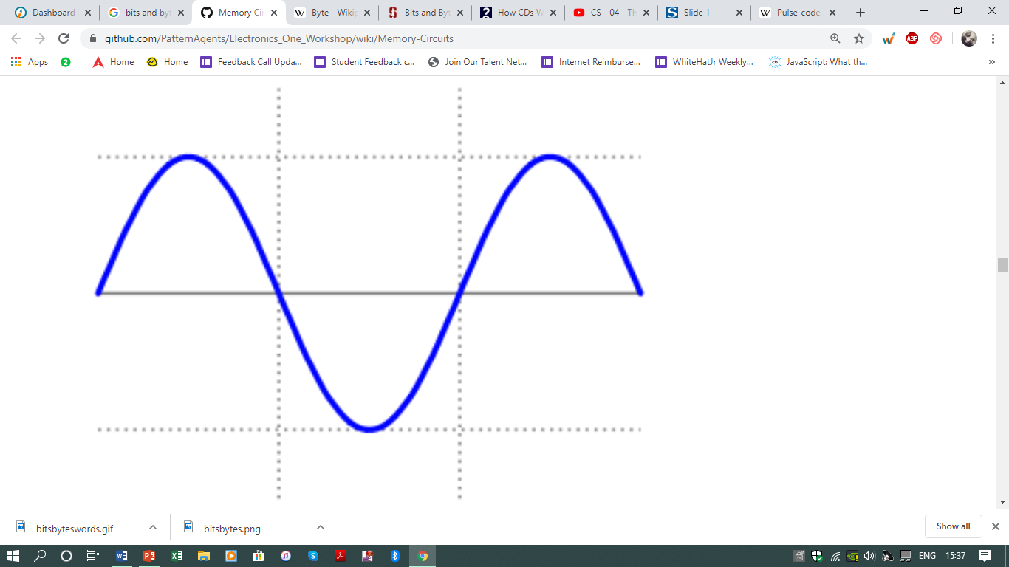
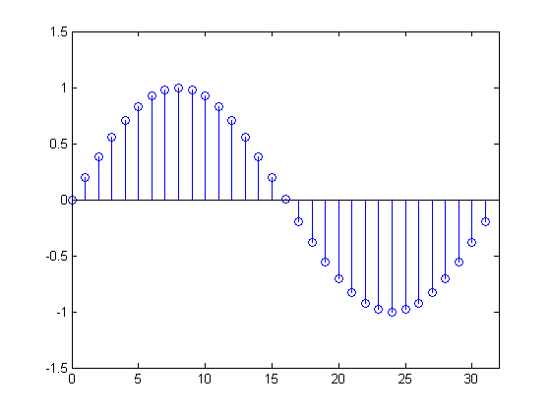
Binary Pulse code Modulation
Pulse-code modulation (PCM) is a method used to digitally represent sampled analog signals.
It is the standard form of digital audio in computers, compact discs, digital telephony and other digital audio applications.
In a PCM stream, the amplitude of the analog signal is sampled regularly at uniform intervals, and each sample is quantized to the nearest value within a range of digital steps.

Slide 8
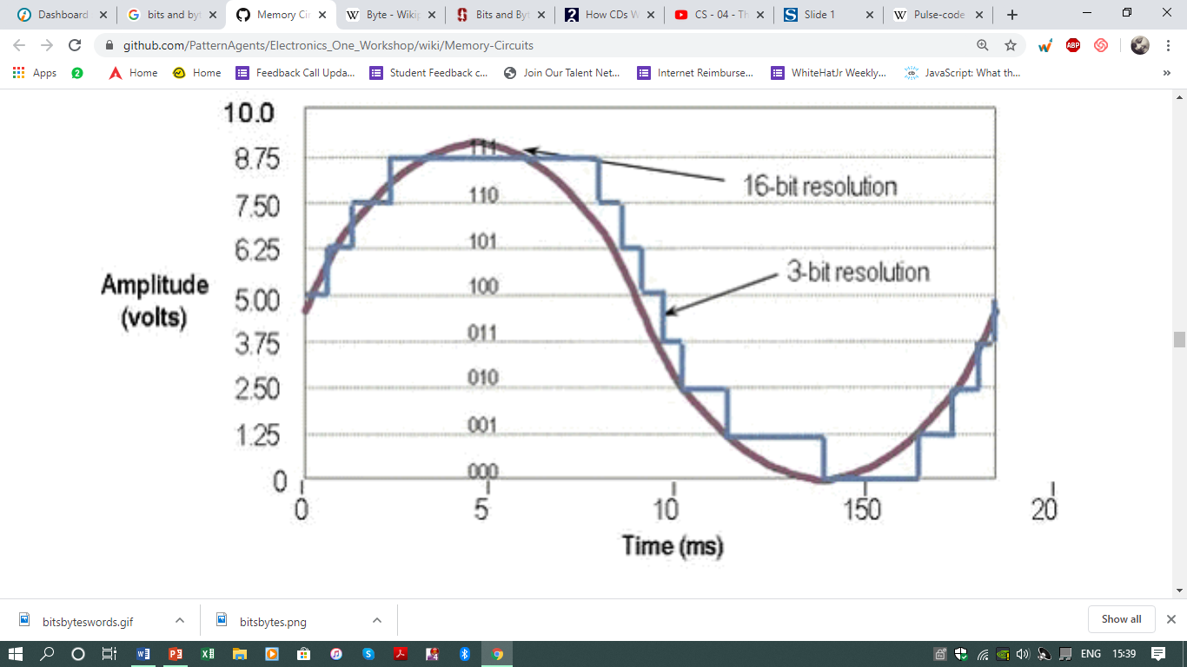

Slide 9
Run length encoding
Run-length encoding (RLE) is a form of lossless data compression in which runs of data (sequences in which the same data value occurs in many consecutive data elements) are stored as a single data value and count, rather than as the original run.
This is most useful on data that contains many such runs.
Consider, for example, simple graphic images such as icons, line drawings, Conway’s Game of Life, and animations. It is not useful with files that don't have many runs as it could greatly increase the file size.

Slide 10


